Slide 1
Category review: Chips
March 2024
Retail Analytics
Brand note: If client logo is not required, use alternate title page layout right click slide thumbnail > Layout > Title

Slide 2
Notes:
To view Privacy video explaining how important data privacy is to Quantium, please click here: https://www.youtube.com/watch?v=Zq1QDAkoRzU
or here Q:\Company Reference\Brand & Design\Brand videos\Q Privacy.mp4
At Quantium, we believe that data is the behavioural footprint of humanity and that it has to be treated with the utmost care and responsibility.
Histories, attitudes, indeed lives are stored within it in ways that aren’t always apparent – and that’s what makes its potential so powerful.
To work with it responsibly, sensitively, we set ourselves the highest data privacy protection and governance standards.
We have spent 17 years perfecting privacy-by-design and secure-by-design principles. Central to this is not holding any personally identifiable information about people –
we neither receive it, and put the necessary protections in place to be unable to decipher it.
Every aspect of handling data is safeguarded: from its de-identification, to its encryption – data security is paramount and of the highest grade.
We pride ourselves on gaining the trust of iconic organisations around the world through years of securely working with their data,
and in turn the trust that builds with their stakeholders.

Slide 3
Executive summary
01
Customer Segmentation
Analysis
The top 3 customer segments responsible for sales are:
budget older families
mainstream retirees
mainstream young singles and couples
The number of customers is the driver of sales in the mainstream retirees and mainstream young singles/couples segments.
The number of chips purchased per customer is the driver of sales in the budget older families segments.
02
Experimentation
and
uplift testing
A new store layout was tested on stores 77, 86, and 88.
With stores 77, 86, and 88 as trial stores, stores 233, 155, and 237 were selected as control stores.
The experiment positively affected the performance of store 77 and 88 but this was not the case for store 86.

Slide 4
01
Category

Slide 5

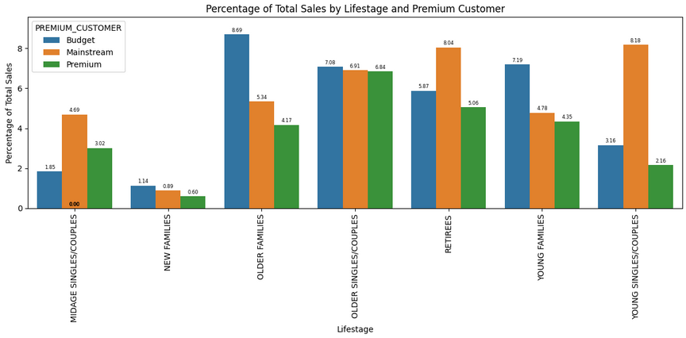
The top three customer segments driving sales are budget older families, mainstream retirees, and mainstream young singles and couples.

Slide 6
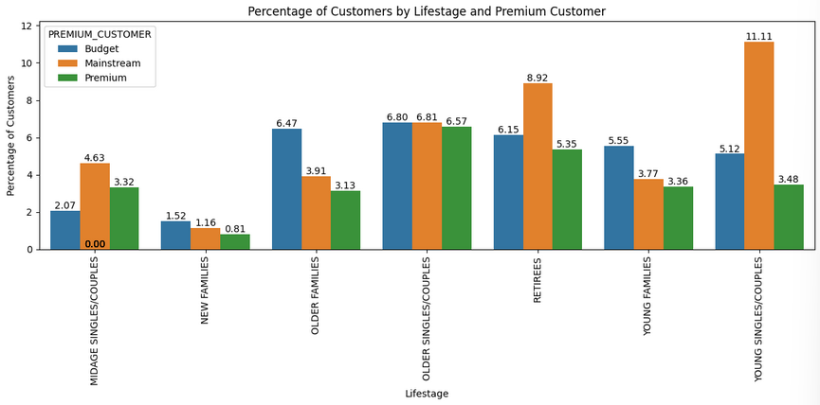
The number of customers is the driver of sales in the mainstream retirees and mainstream young singles/couples segments.

Slide 7
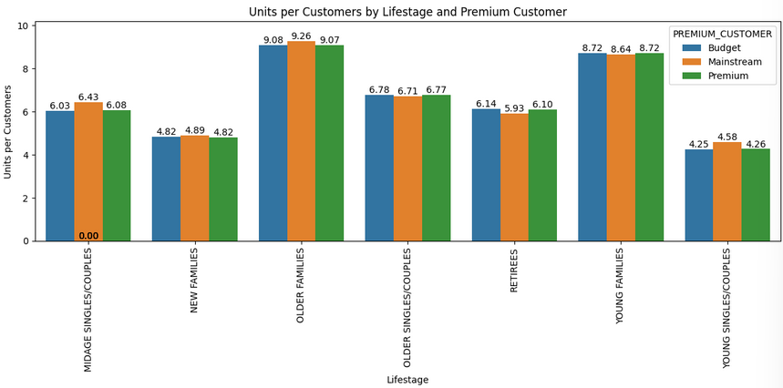
The number of chips purchased per customer is the driver of sales in the budget older families segments.

Slide 8

Product categories preferred by top 3 customer segments
The top 3 customer segments prefer the following category of products:
Brands: Kettle, Smith, Doritos, Pringles
Size: 175g, 150g, 134g, 110g, 170g

Slide 9
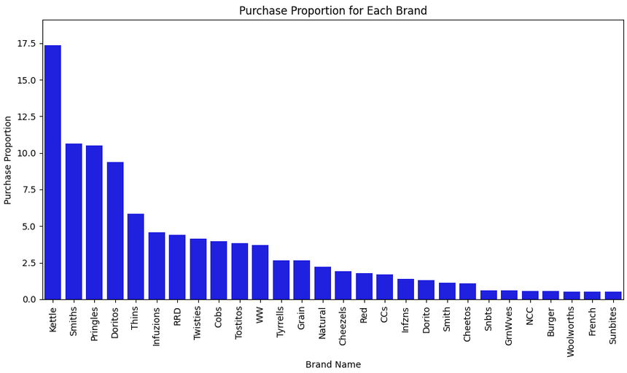
Product categories preferred by top 3 customer segments

Slide 10
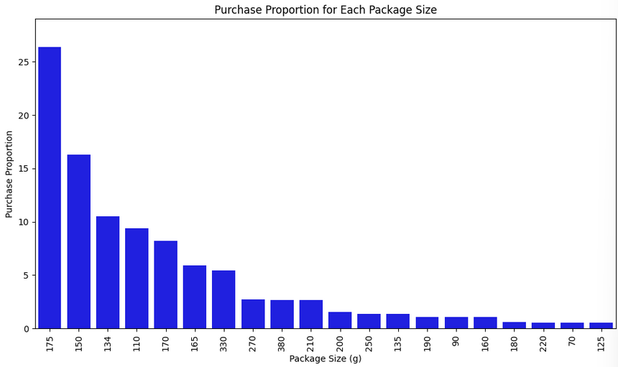
Product categories preferred by top 3 customer segments (Cont’d)

Slide 11
02
Experimentation and uplift testing

Slide 12
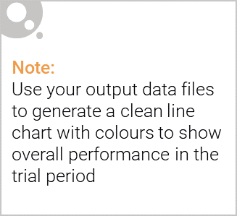
Introduction
A trial store is a store on which a new strategy was carried out for a period of time.
A control store is a store whose performance before the experiment was similar to the control store.
For this project a new store layout was tested on trial stores 77, 86, and 88, with stores 233, 155, and 237 as control stores.
In this analysis the performance of the control store was compared to the respective trial store during the experimental period to gauge the effect of the experiment

Slide 13

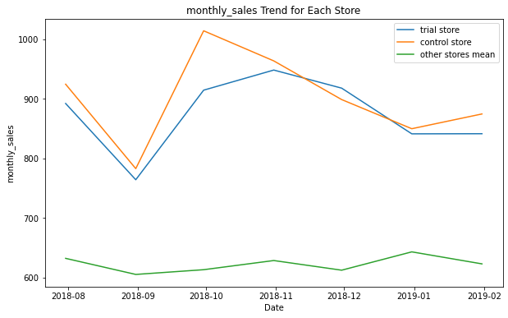
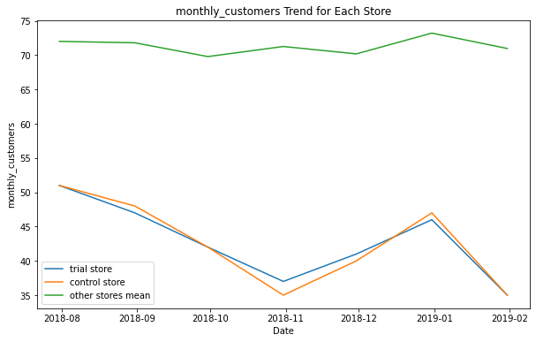
Store 77 (Trial), Store 233 (Control), and other stores pre trial period

Slide 14
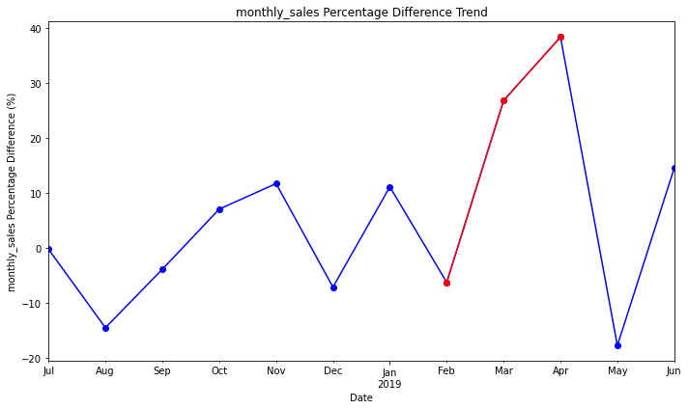
The percentage difference in performance between 77 and 233 is positively affected by the experiment

Slide 15
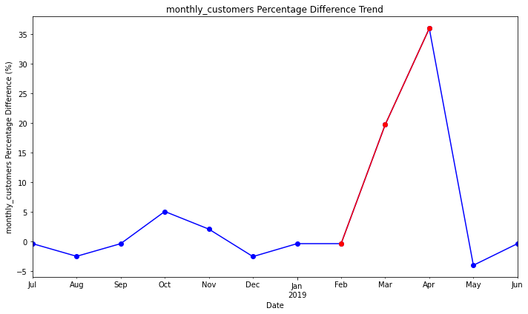
The percentage difference in performance between 77 and 233 is positively affected by the experiment

Slide 16
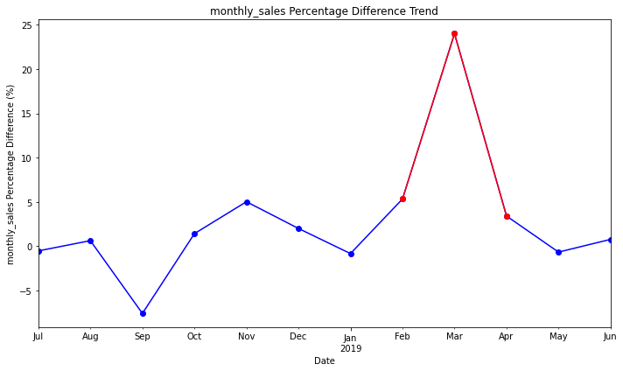
The experiment had a mixed effect on the performance of store 86 (trial) when compared to Store 155 (control).

Slide 17
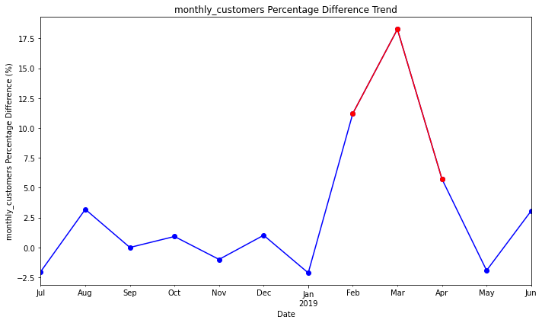
The experiment had a mixed effect on the performance of store 86 (trial) when compared to Store 155 (control).

Slide 18
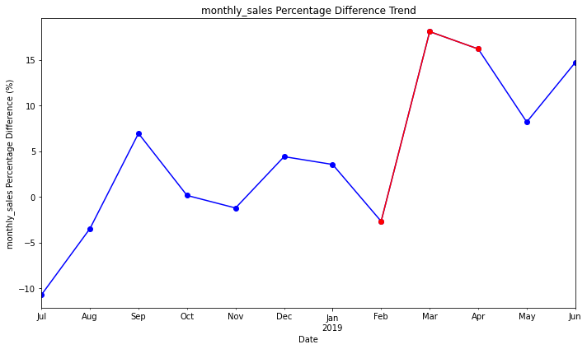
The percentage difference in performance between 88 (trial) and 237 (control) is positively affected by the experiment

Slide 19
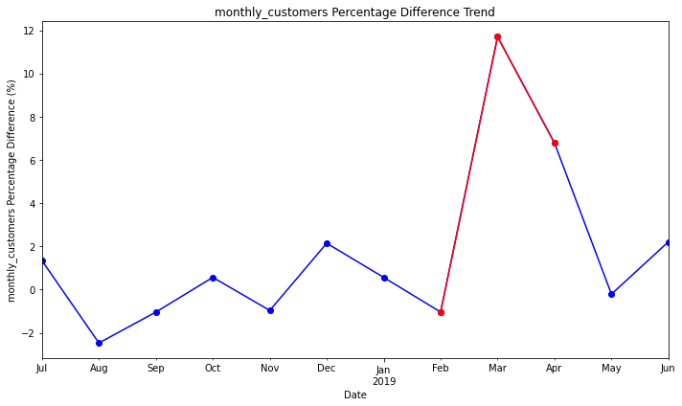
The percentage difference in performance between 88 (trial) and 237 (control) is positively affected by the experiment

